Slide 1
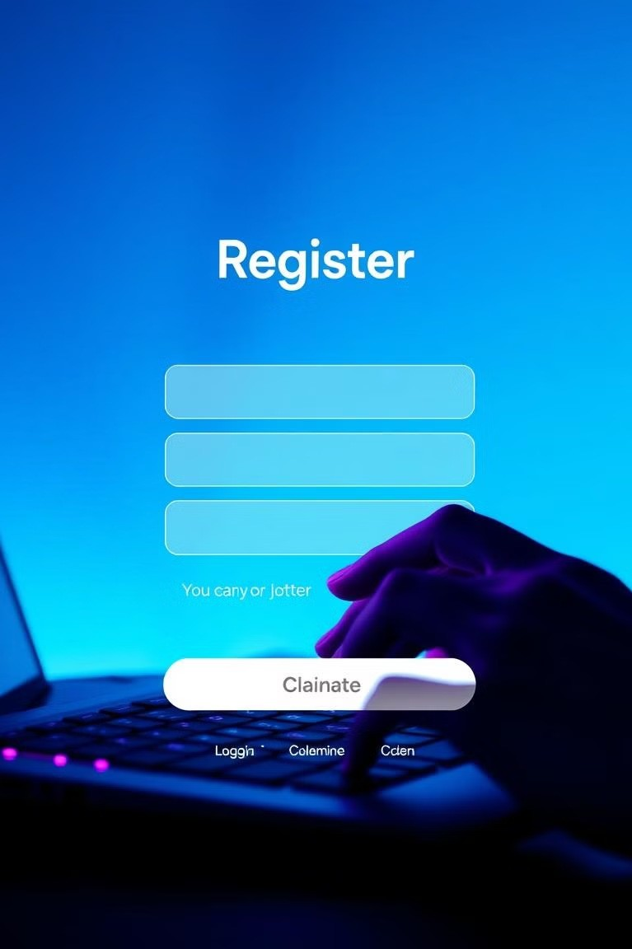
Registration and Login Form
In today's digital world, user experience is paramount. A well-designed registration and login process is crucial for both user satisfaction and business success. This presentation explores the core concept of streamlining user registration and login, examining a potential code solution and its analysis.

Slide 2
Done by :
K.SHASHANK-AP23110010301​
T.ABHIGNA-AP23110010310​
M.GEETHIK-AP23110010262​
S.NAINEY-AP23110010333

Slide 3
INDEX
*PROBLEM STATEMENT​
*INTRODUCTION​
*CORE CONCEPT ​
*CODE​
*INPUT/OUTPUT​
*CODE ANALYSIS​
*CONCLUSION

Slide 4
The Problem Statement
Cluttered Forms
Overly complex forms with unnecessary fields can discourage users and increase the risk of abandonment.
Password Fatigue
Users struggle to remember multiple passwords, leading to frustration and potential security risks.
Slow Response Times
Sluggish registration and login processes can create negative user experiences and impact conversion rates.

Slide 5

Introduction
1
1. Simplified Forms
Focus on essential fields and minimize unnecessary information requests.
2
2. Social Login Integration
Allow users to sign in using existing social media accounts, reducing friction.
3
3. Passwordless Authentication
Explore alternative authentication methods, such as biometrics or one-time codes, to eliminate password management.

Slide 6
CORE CONCEPT
1
User Authentication:
Ensures that only valid users can access the system.
Involves verifying user credentials (like username and password).
2
Data Validation :
Checks input fields for proper formatting and validity during registration (e.g., email format, password strength).
Ensures no invalid or malicious data (e.g., SQL injection) is submitted..
3
Password Management:
Hashing: Passwords are not stored in plain text. Instead, they are hashed using secure algorithms like bcrypt, SHA-256, etc.
Salting: Random data is added to the password before hashing to prevent attacks like rainbow table attacks.

Slide 7
CODE
INPUT​
#include <iostream>​
#include <fstream>​
#include <string>​
#include <unordered_map>​
using namespace std;​
unordered_map<string, string> ​
loadUsers() { ​
unordered_map<string, string> users; ​
ifstream infile("users.txt"); string username, password; ​
while (infile >> username >> password) { ​
users[username] = password; ​
}

Slide 8
infile.close(); ​
return users;​
}​
void saveUsers(const unordered_map<string, string>& users) ​
{ ​
ofstream outfile("users.txt"); ​
for (const auto& user : users) ​
{ ​
outfile << user.first << " " << user.second << endl;​
} ​
outfile.close();​
}​
void registerUser(unordered_map​
<string, string>& users){​
{ ​
string username, password; ​
cout << "Enter a new username: "; ​
cin >> username; if (users.find(username) != users.end())​
{ ​
cout << "Username already exists. Try another one.\n"; ​
return; }

Slide 9
cout << "Enter a new password: "; ​
cin >> password; ​
users[username] = password; ​
saveUsers(users); ​
cout << "Registration successful!\n";}​
(const unordered_map<string, string>& users) { ​
string username, password; ​
cout << "Enter username: ";​
cin >> username; cout << "Enter password: "; ​
cin >> password;​
if (users.find(username) != users.end() && users.at(username) == password)​
cout << "Login successful! Welcome, " << username << ".\n"; ​
} else { ​
cout << "Invalid username or password.\n"; }}

Slide 10
​
functionvoid resetPassword(unordered_map<string, string>& users) { ​
string username; ​
cout << "Enter your username: "; ​
cin >> username; ​
if (users.find(username) == users.end()) { ​
cout << "Username not found.\n"; ​
return; ​
} ​
string newPassword; ​
cout << "Enter a new password: "; ​
cin >> newPassword; users[username] = newPassword; ​
saveUsers(users);​
cout << "Password reset successful!\n";​
}

Slide 11
​Main() ​
{ ​
nordered_map<string, string>​
users = loadUsers​
int choice; ​
do { ​
cout << "\n=== Menu ===\n"; ​
cout << "1. Register\n"; ​
cout << "2. Login\n"; ​
cout << "3. Forgot Password\n"; ​
cout << "4. Exit\n"; ​
cout << "Enter your choice: "; ​
cin >> choice;
}

Slide 12
switch (choice) ​
{ ​
case 1: ​
registerUser(users); ​
break; ​
case 2: ​
loginUser(users); ​
break; ​
case 3: ​
resetPassword(users); ​
break; ​
case 4: ​
cout << "Exiting program. Goodbye!\n"; ​
break;

Slide 13
default: ​
cout << "Invalid choice. Please try again.\n"; ​
} ​
}​
while (choice != 4); ​
return 0​
;}

Slide 14
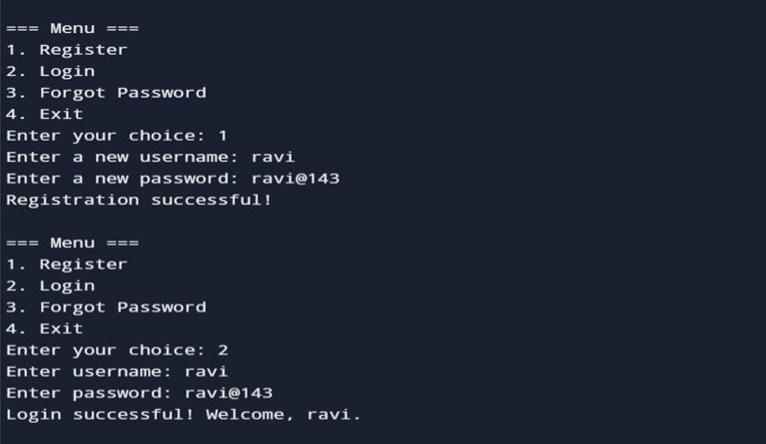
OUTPUT

Slide 15
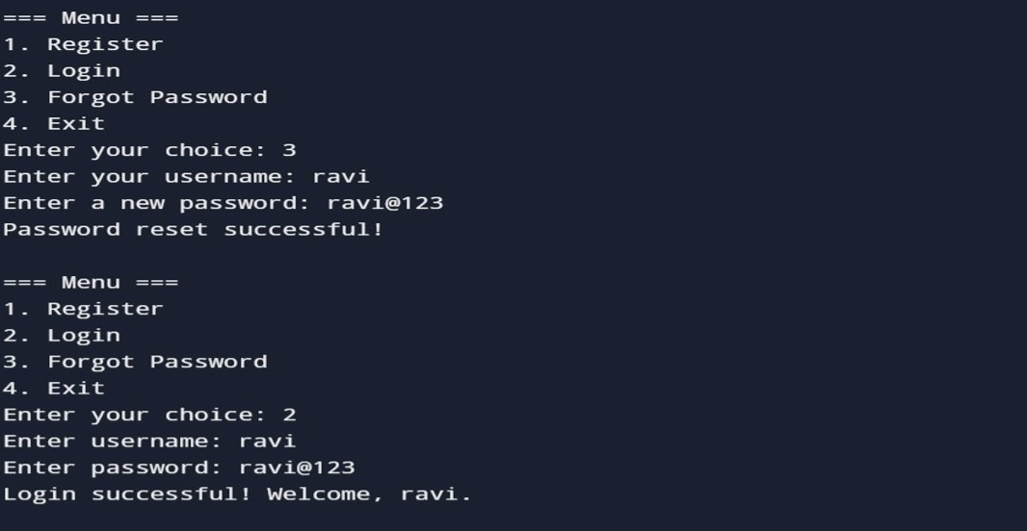

Slide 16
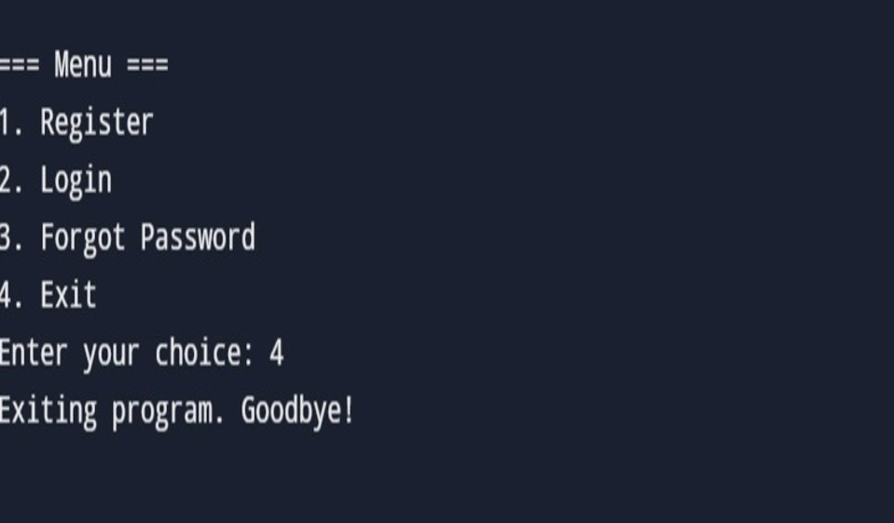

Slide 17
Code Analysis and Evaluation
Efficiency
Minimal code, fast loading times.
1
Scalability
Easily adaptable to different platforms.
2
Security
Secure data handling and user authentication.
3

Slide 18
CONCLUSION A registration and login form is essential for securely managing user access to applications. It ensures data security through encryption and hashing, provides smooth user experiences with clear validation and error handling, and relies on strong backend systems for reliable authentication and database interaction. A well-designed form balances security, usability, and scalability, making it a critical feature for modern applications.

Slide 19
THANK YOU

